Slide 1
19Z601- Machine Learning
Presented by
Ms.Anisha.C.D
Assistant Professor
CSE

Slide 2
Syllabus
INTRODUCTION : Types of Learning - Designing a learning system - concept learning - Find-s Algorithm - Candidate Elimination - Data Preprocessing - Cleaning - Data Scales - Transformation - Dimensionality Reduction. (9)
LINEAR MODELS : Linear Regression Models ,Maximum Likelihood Estimation - Least Squares - Bias-Variance Decomposition - Bayesian Linear Regression - Linear Models for Classification, Probabilistic Generative Models - Probabilistic Discriminative Models - Linear Discriminant Analysis (9)

Slide 3
Syllabus
NEURAL NETWORKS AND DECISION TREES : Feed-forward Networks - Network Training - Delta Rule- Gradient Descent – Error Backpropagation - Regularization in Neural Networks - Generalisation - Decision Tree Learning- Representation - Inductive Bias- Issues (9)
KERNEL AND GRAPHICAL METHODS : Constructing Kernels - Radial Basis Function Networks – Gaussian Processes - Maximum Margin Classifiers - SVM - Bayes Theorem - Naive Bayes - Bayesian Networks (9)

Slide 4
Syllabus
UNSUPERVISED AND REINFORCEMENT LEARNING : Measures of Similarity and Dissimilarity - Clustering - Partitioning methods - KMeans - Hierarchical Methods - Outliers - Reinforcement Learning - Reinforcement Learning Tasks - Q-learning (9)

Slide 5
Text Books and Reference Books
TEXT BOOKS:
1. Tom Mitchell , "Machine Learning", McGraw Hill, 2017.
2. Christopher M Bishop , "Pattern Recognition and Machine Learning Learning", Springer, 2011.
REFERENCES:
1. Ethem Alpaydin , "Introduction to Machine Learning", 3rd Edition, PHI Learning, 2015.
2. Trevor Hastie, Robert Tibshirani, Jerome friedman , "The Elements of Statistical learning", 2nd Edition, Springer, 2017.
3. Kevin Murphy , "Machine Learning - A Probabilistic Perspective", MIT Press, 2012.
4. Yaser S. Abu-Mostafa , "Learning from Data", AML, 2017.

Slide 6
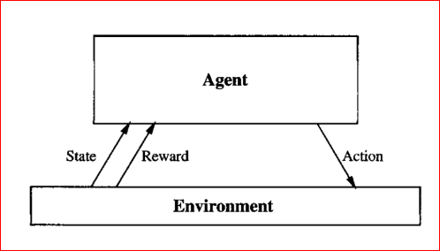
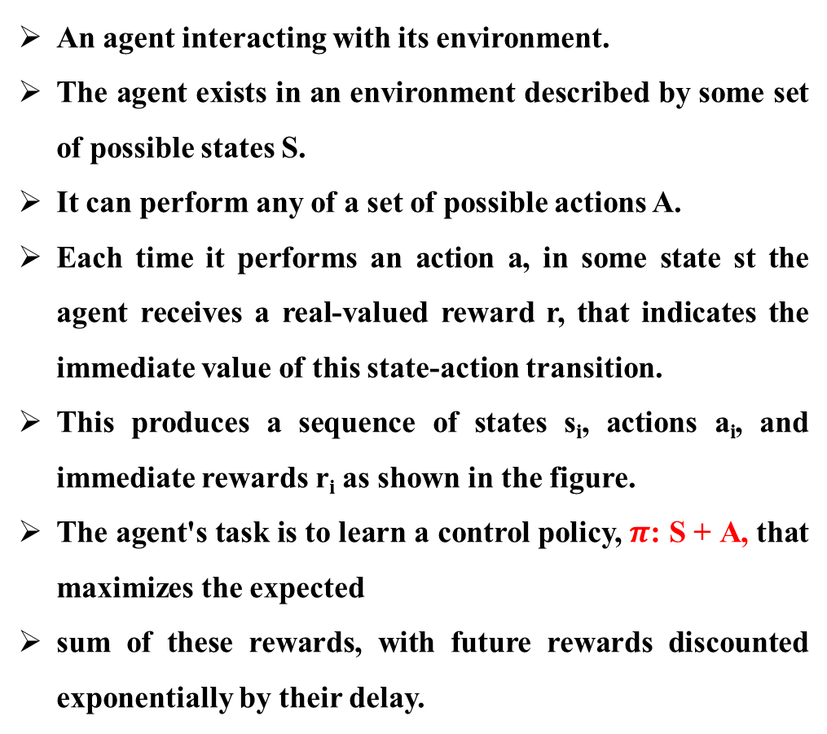
_{Reinforcement Learning}
Reinforcement learning addresses the question of how an autonomous agent that senses and acts in its environment can learn to choose optimal actions to achieve its goals.
An agent interacting with its environment.
The agent exists in an environment described by some set of possible states S.
It can perform any of a set of possible actions A.
Each time it performs an action a, in some state st the agent receives a real-valued reward r, that indicates the immediate value of this state-action transition.
This produces a sequence of states s_{i}, actions a_{i}, and immediate rewards r_{i} as shown in the figure.
The agent's task is to learn a control policy, $π$: S + A, that maximizes the expected
sum of these rewards, with future rewards discounted exponentially by their delay.

Slide 7
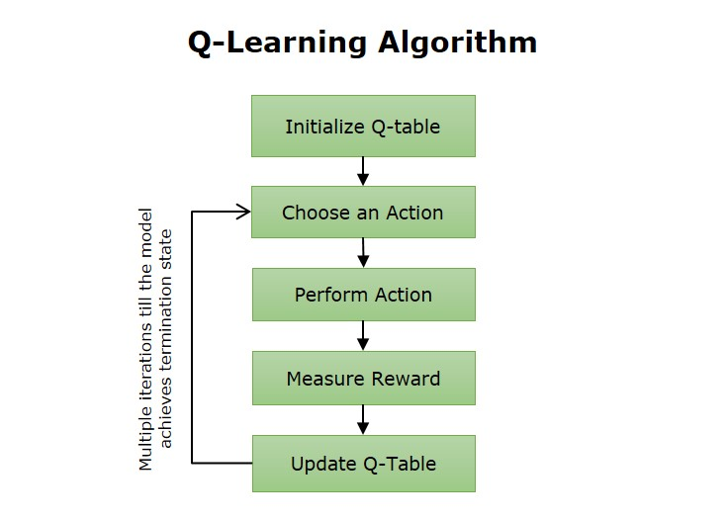

Q Learning
Where,
Q(s,a) represents the expected reward for an action 'a' in state 's'.
R (s,a) represents the reward earned when action a is carried out in state 's'.
ɑ is the discount factor, which denotes the significance of future rewards.
max_{a}Q(s',a) represents the maximum Q-value for the next state s' and every possible action.

